Slide 1
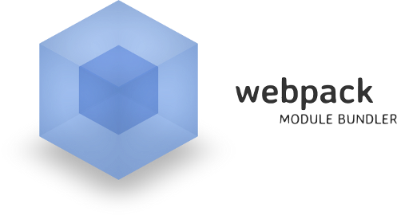
Project Architecture
Packages, Dependencies, Webpack
SoftUni Team
Technical Trainers
Software University
https://softuni.bg

Slide 2
Have a Question?
sli.do #js-advanced

Slide 3
Table of Contents
What is Webpack?
Installation
Configuration
Basic Builds

Slide 4

Webpack
A Wicked Smart Module Bundler

Slide 5



What is Webpack?
One of the most popular build tools
Bundles JavaScript files for usage in a browser
Supports dependency management
Can load any 3rd party library as a module
Comes with it's own development server
JS
JS
JS
JS
Bundle
CSS
CSS
CSS
CSS

Slide 6
What Does Webpack Do?
Manages dependencies
require
import
Build tasks - convert and preprocess
Minify
Combine
Sass / Less conversion
Babel transpile
Combines the build system and module bundling

Slide 7
Code Splitting
All in one request
+ Less latency
- Get all bunch
Request per module
+ Get only what you need
Much overhead
Requests latency
Modules to chunks
+ Get only what you need
+ Less requests,
less overhead

Slide 8

Webpack Build Process
JS
JS
JS modules with dependencies
JS
JS
JS
Stylesheets
Bundle
Deployment
CSS
CSS
CSS
Images and other assets

Slide 9

Webpack Installation

Slide 10
Installation and CLI
Install Webpack via npm
Install the Webpack command line interface
Install the add-on development server
npm install webpack --save-dev
npm install webpack-cli --save-dev
npm install webpack-dev-server --save-dev

Slide 11
Package.json
Change package.json file
{
"name": "Demo",
"version": "1.0.0",
"description": "",
"private": true,
"main": "index.js",
"scripts": {
"test": "echo \"Error: no test specified\" && exit 1"
},
"keywords": [],
"author": "",
"license": "ISC",
"devDependencies": {
"webpack": "^4.35.3",
"webpack-cli": "^3.3.5",
"webpack-dev-server": "^3.7.2"
}

Slide 12
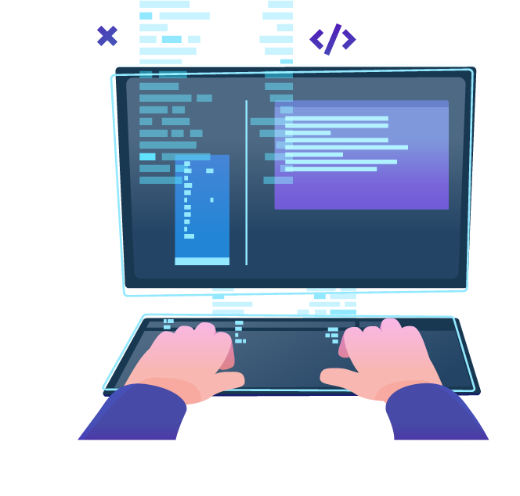
Config File, Watch Mode, Production
Basic Builds

Slide 13
Adding a Config File
Create a webpack.config.js to automate your build
Configuration is in JSON format
When running npx webpack from the terminal, it uses this config
module.exports = {
entry: "./app.js",
output: {
filename: "bundle.js",
path: path.resolve(__dirname,'dist')
}
};
Starting module
Final output file
Destination path

Slide 14
Enable Watch Mode
Webpack can watch for file changes and rebuild the bundle
Add an argument or change your config file to enable hot reloading
npx webpack --watch
module.exports = {
entry: … ,
output: … ,
watch: true
};

Slide 15
Web Server with Watch Mode
Run the development server from the terminal
Change your config file to enable hot reloading
npx webpack -dev-server --open
module.exports = {
entry: … ,
output: … ,
devServer: {
publicPath: "/dist/",
watchContentBase: true,
}
};

Slide 16
Building Multiple Files
Requiring files
Adding an additional entry file to our webpack.config.js file
require("./file")
module.exports = {
entry: ["./global.js", "./app.js"],
output: {
filename: "bundle.js"
}
};

Slide 17
Processing Files with Loaders
Loaders apply transformations to files
Can be downloaded with npm and configured in the main config
Preloaders are the same, they just run before any loaders
module.exports = {
entry: "./entry.js",
output: {filename: "bundle.js"},
module: {
rules: [ … ]
}
};
Loader format
{
test: /\.css$/,
exclude: /node_modules/,
loader: "style-loader"
}

Slide 18
Creating a Start Script
Webpack uses npm scripts for further automation
Add to your package.json file
Instead of running npx webpack-dev-server, we can run the following instead
scripts: {
"start": "webpack-dev-server --open"
};
npm start

Slide 19
Production and Development Builds (1)
To minify the bundle for deploy, run webpack with –p argument
Install strip-loader
Strips arbitrary functions out of your production code
Create webpack-production.config.js
You can specify a different config file for production
npx webpack -p
npm install strip-loader --save-dev
npx webpack --config webpack-production.config.js -p

Slide 20
Production and Development Builds (2)
In the webpack-production.config.js write the following code:
Require the strip-loader npm module
Require the original webpack configuration file
let WebpackStripLoader = require('strip-loader');
let devConfig = require('./webpack.config.js');

Slide 21
Production and Development Builds (3)
Create a new object, and pass in the test, exclude and loader keys
let stripLoader = {
test: [/\.js$/, /\.es6$/],
exclude: /node_modules/,
loader: WebpackStripLoader.loader('console.log')
}

Slide 22
Production and Development Builds (4)
Push the new object into our loaders array from our original config
Export our new config object
devConfig.module.loaders.push(stripLoader);
module.exports = devConfig;

Slide 23

Live Exercise in Class
Practice

Slide 24

Summary
Arrow functions ≈ short function syntax
Webpack is a module bundler. It relies on:
Dependency graph underneath
Loaders and plugins
Its configuration describes how to transform assets of the graphs
Features like code splitting are used
It comes with its own development server

Slide 25
Questions?
Notes:
25

Slide 26













SoftUni Diamond Partners

Slide 27


Educational Partners

Slide 28
Trainings @ Software University (SoftUni)
Software University – High-Quality Education, Profession and Job for Software Developers
softuni.bg, about.softuni.bg
Software University Foundation
softuni.foundation
Software University @ Facebook
facebook.com/SoftwareUniversity
Software University Forums
forum.softuni.bg
Notes:
28

Slide 29

License
This course (slides, examples, demos, exercises, homework, documents, videos and other assets) is copyrighted content
Unauthorized copy, reproduction or use is illegal
© SoftUni – https://about.softuni.bg/
© Software University – https://softuni.bg
Notes:
29

